Slide 1
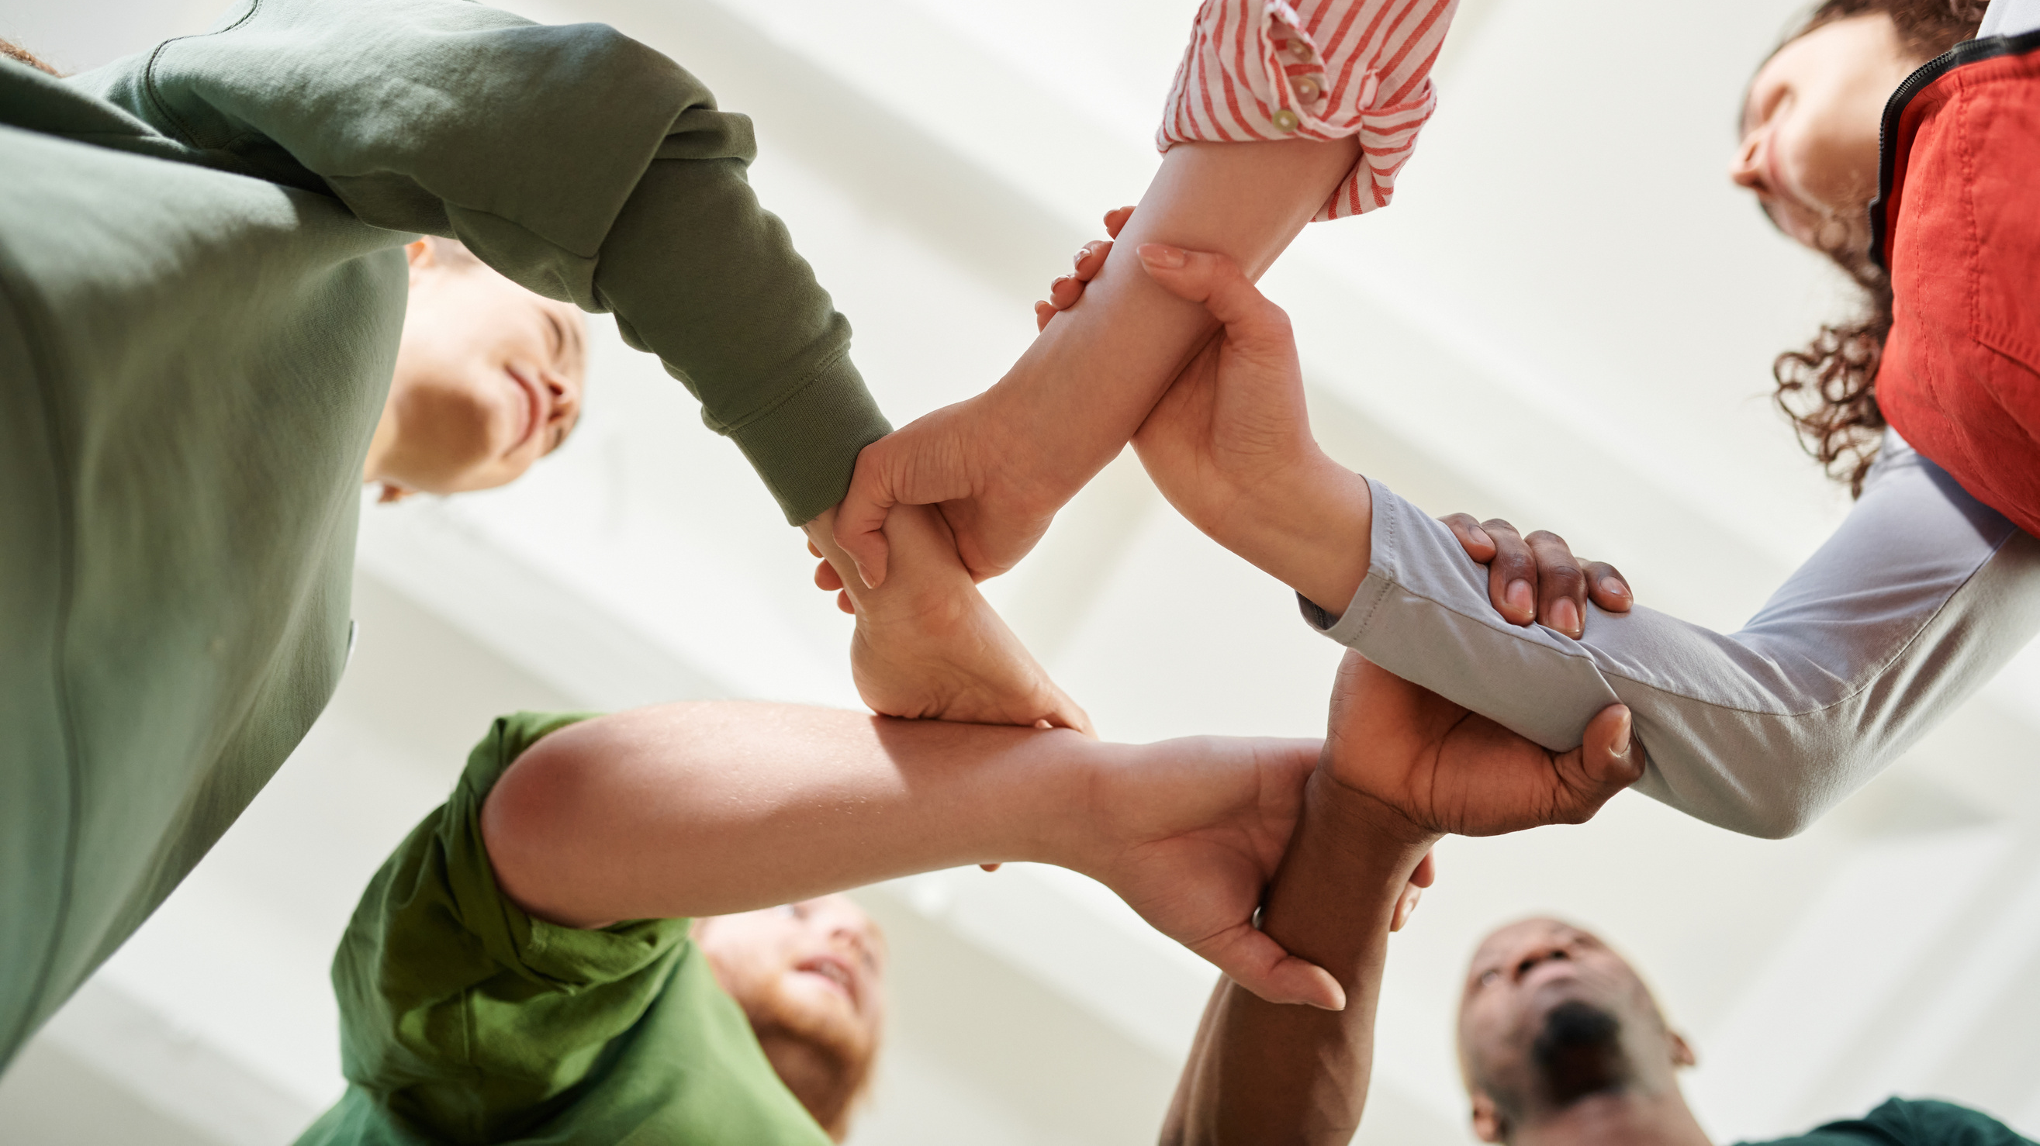
BUILD CONNECTION & COMMUNICATION

Slide 2
Group Check-In Activity
Form small groups of 3-5 people

Slide 3
The Question:
What kind of day
have you had so far?
Group Check-In

Slide 4
"The Rules"
This is a safe space .
Each person takes a turn answering the question.
Everyone listens - no interrupting or follow up questions.
We are not creating dialogue, we are giving each person space to share.
Thank each person after they have shared, and move to the next person.
Group Check-In

Slide 5
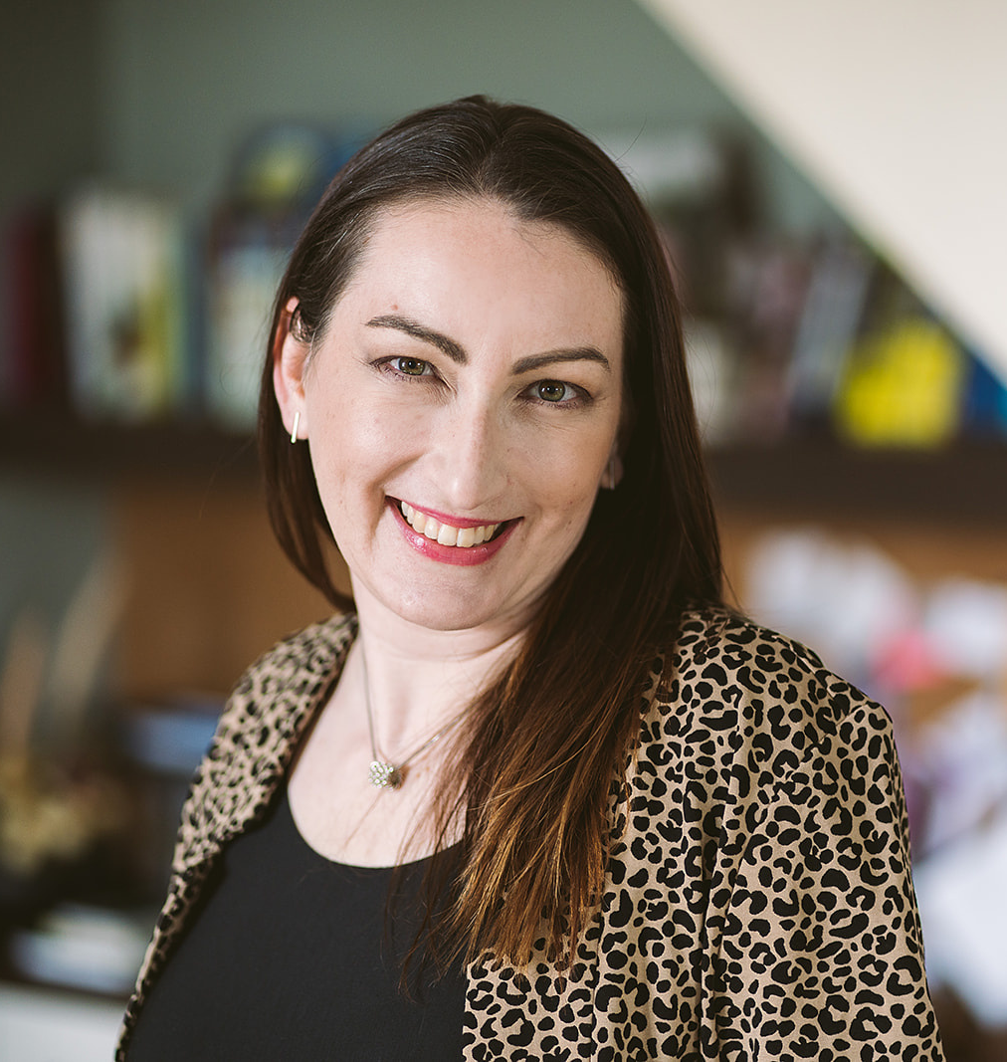
ALISON BUTLER CONSULTING
Thanks for being here
EMAIL
contact@alisonbutler.ca
WEBSITE
alisonbutler.ca
Alison Butler

